Slide 1




CodiaC++
A mind blowing intro to Computer Science
By
Designed and presented by
Carin Samer

Slide 2

Introduction to Competitions
Today's Question Bank
Your first problem
Designed and presented by
Carin Samer

Slide 3

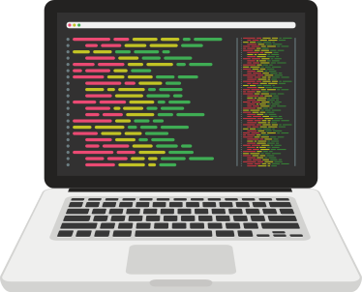
Why are we learning to code that way?
Designed and presented by
Carin Samer

Slide 4
At the end of the lesson, you'll be able to:
Solve your first ever programming problem!
DID YOU KNOW?
In competitive programming , the contests are usually held over the Internet or a local network. Contestants are referred to as sport programmers.
National and international programming competitions

Slide 5

What’s next?

Slide 6



Competitions
There numerous competitions held out there, like the EOI, IOI,ECPC, IIOT, IEEE Xtreme and Meta Hacker Cup.
These competitions are hosted annually, also there are numerous websites that offers weekly and bi-weekly competitions such as Codeforces , leetcode and AtCoder.
50% of the brain is active in visual processing
Designed and presented by
Carin Samer

Slide 7

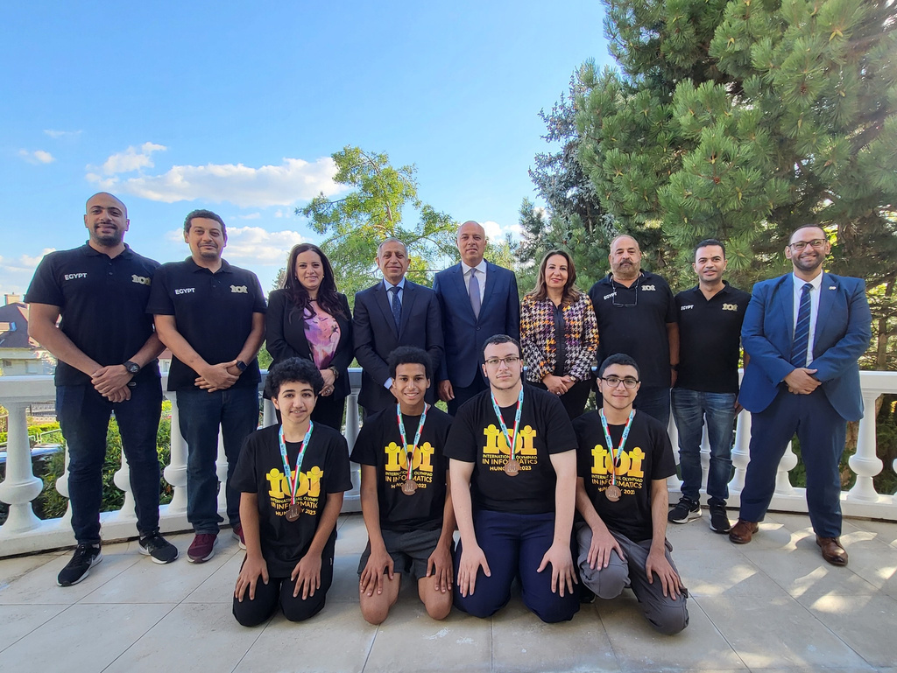
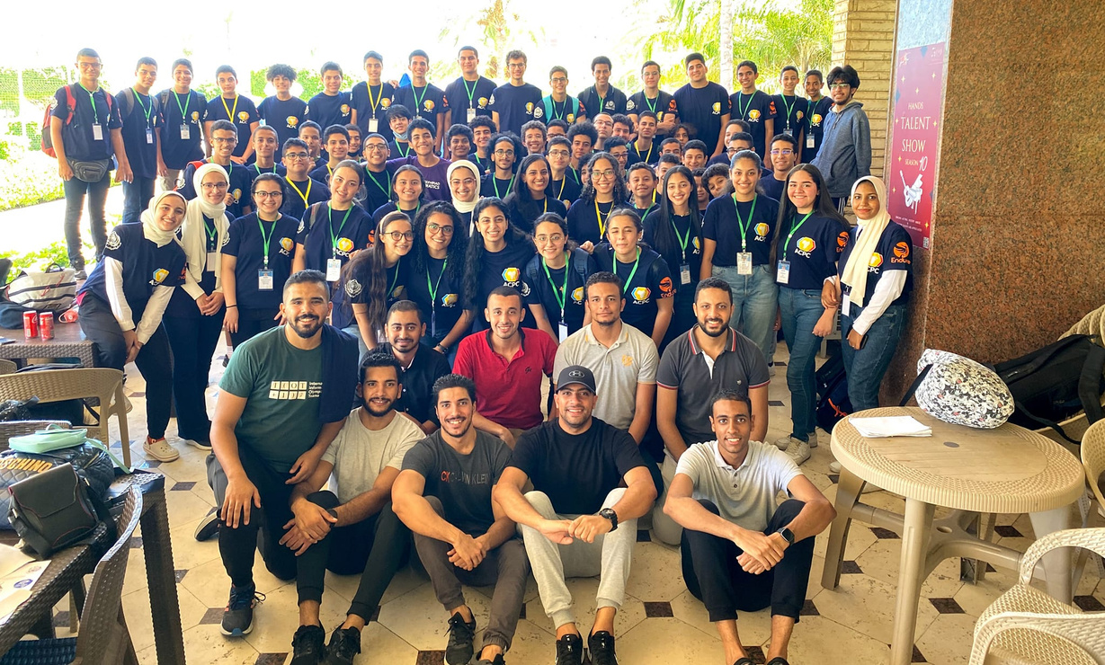
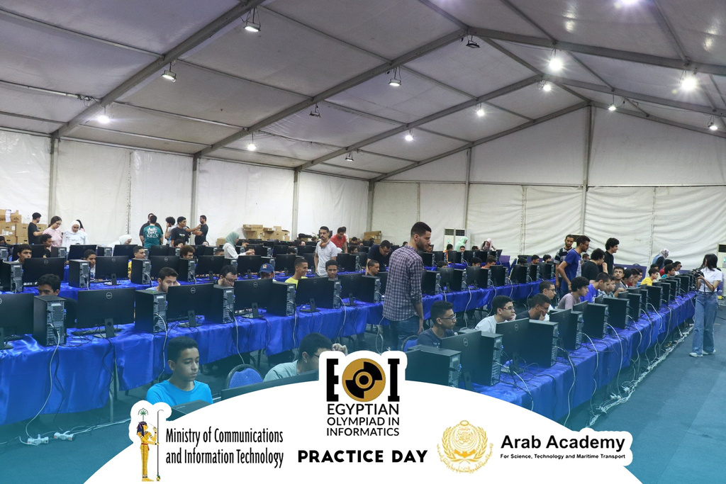
Gallery
ECPC Teens 2022
IOI 2023 - Hungary
EOI 2023
Designed and presented by
Carin Samer

Slide 8
Discussion :
Training Strategy

Slide 9



Feeling Great!
1
2
3
4
5
Temperature Check
Is everything clear till now? Send in chat
Lost

Slide 10
FINALLY!!!
It’s time to solve your first ever programming problem!

Slide 11


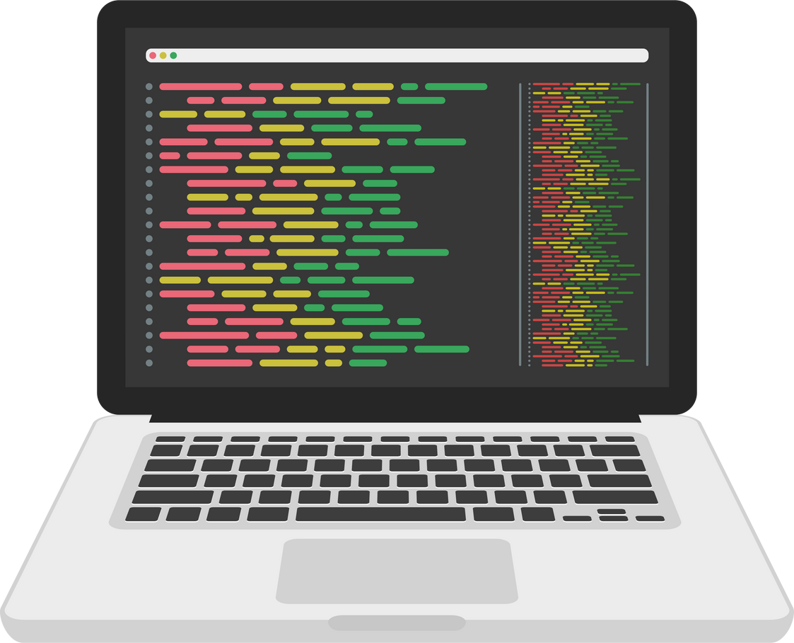
Try This!
Open the link sent in chat
Read the problem Carefully
Grab a pen and a paper and think about it calmly.
Try translating your idea into code using the concepts we’ve learned.
Designed and presented by
Carin Samer

Slide 12
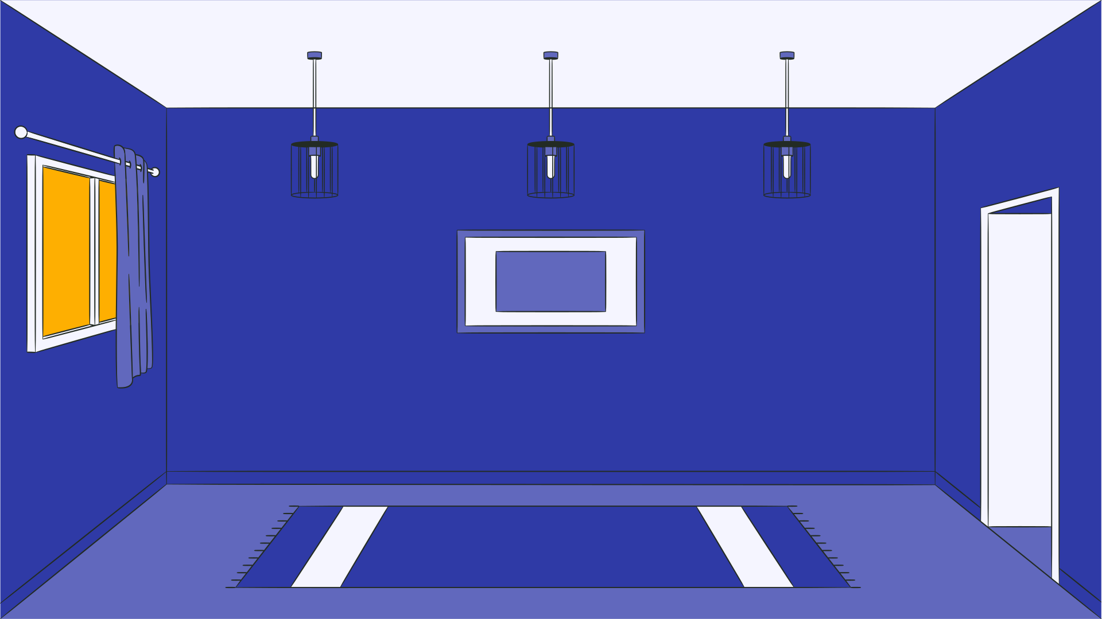




THAT’S IT!
Designed and presented by
Carin Samer

